Slide 1
Calculation Groups & C#
- The Perfect Couple

Slide 2









Thank you!
Many thanks to our sponsors, without whom such an event would not be possible.

Slide 3


Paulina Jędrzejewska
Born in Poland
Studied business mathematics in Germany
Living in Switzerland
Working with Power BI since 2018
Microsoft Certified Trainer

Slide 4
Agenda
What makes it the perfect couple?
C# Scripting
Calculation Groups
Power Couple in action

Slide 5
What makes it the perfect couple?
Notes:
Who works with Power BI?
Who knows Calculation Groups? Who knows C#?
Who alredy Scripted in Power BI? Tell why is this topic important to you

Slide 6




Self Service Stages
No Self Service
Medium Self Service
Full Self Service
Notes:
No Self Service
Fully depended on the BI Department
Semantic Models and Reports are created by the BI Department
Only read rights
No technical skills needed
Medium Self Service
Cooperation between BI and Users
Semantic Models are still developed by the BI Department
Users are building Reports
Users need basic Power BI knowledge and visualization skills
Full Self Service
Fully independent
Users are building Semantic Models and Reports
BI Department takes only the admin role
Users need good Power BI Skills

Slide 7
Showcase
Notes:
Showcase File

Slide 8
C# Scripting

Slide 9
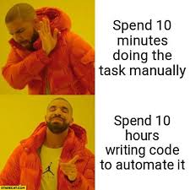
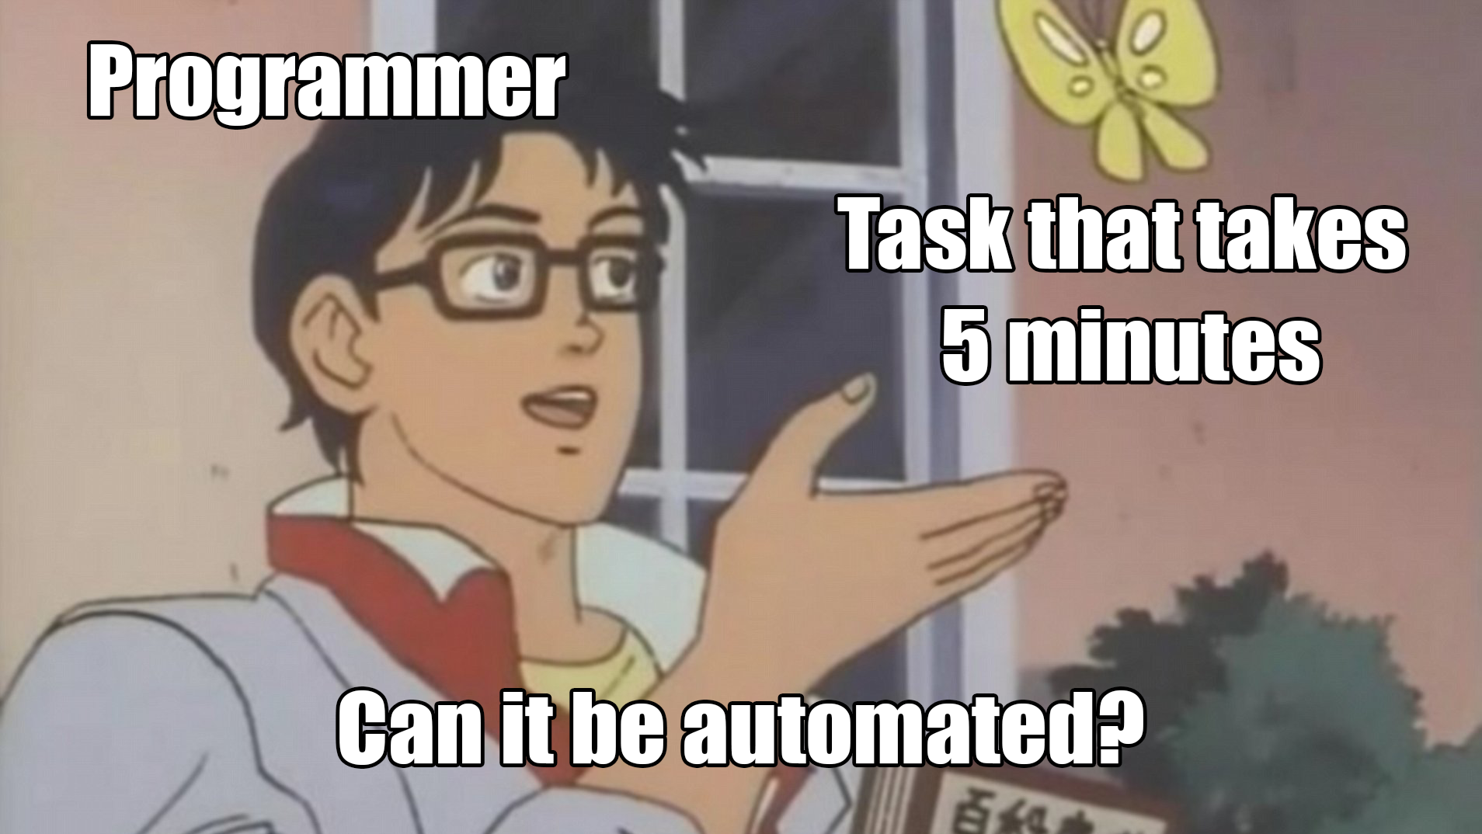

Slide 10
Tasks you can automate with C#
Creating and deleting measures
Renaming objects
Moving objects into folders
Formatting objects
Notes:
Creating and deleting measures
Renaming objects
Moving objects into folders
Formatting objects

Slide 11
Advantages of scripting
Works through a bunch of objects in seconds
Reusable
Homogeneous structure and naming
No more tedious tasks for you!
Notes:
Works through a bunch of objects in seconds
Reusable
Homogeneous structure and naming
No more tedious tasks for you!

Slide 12
What do you need to start scripting?
Tabular Editor 2
Power BI Desktop
Code Editor
Notes:
Tabular Editor 2
Power BI Desktop
Code Editor

Slide 13
Demo
Notes:
Show the Model in PBI
Start with "Hello World".Output();
Then show the Model in Tabular Editor
Show the different usefull features
Generate measures from columns
Delete measures
Add Description

Slide 14
Calculation Groups

Slide 15
Definition
Feature in Data Modeling
Calculation Container
Multiple Measure Application
No Alteration to Base Measures
Tabular Editor needed
Notes:
Feature in Data Modeling: A tool used in the data modeling phase of business intelligence.
Calculation Container: Acts as a container for a set of related calculations.
Multiple Measure Application: Allows applying calculations to multiple measures simultaneously.
No Alteration to Base Measures: Calculations are applied without changing the original measure definitions.

Slide 16
Purpose
Simplification of Complex Models
Enhanced Report Flexibility
Consistency and Maintainability
Notes:
Simplification of Complex Models: Calculation groups simplify complex business intelligence models by reducing the need to create multiple variations of the same measure. This is particularly useful in scenarios with many measures that need similar, repetitive adjustments (e.g., time intelligence calculations, currency conversions).
Enhanced Report Flexibility: They enable report users to apply different calculations to measures dynamically through slicers or other report interactions, enhancing the flexibility and interactivity of reports.
Consistency and Maintainability: By centralizing calculations, they ensure consistency across reports and make the model more maintainable, as changes need to be made in only one place.

Slide 17
Use Cases
Time intelligence
Currency Conversion
Dynamic Measure Formatting
Dynamic Aggregations

Slide 18
Demo
Notes:
Calc Groups erstellen

Slide 19
C# Basics

Slide 20
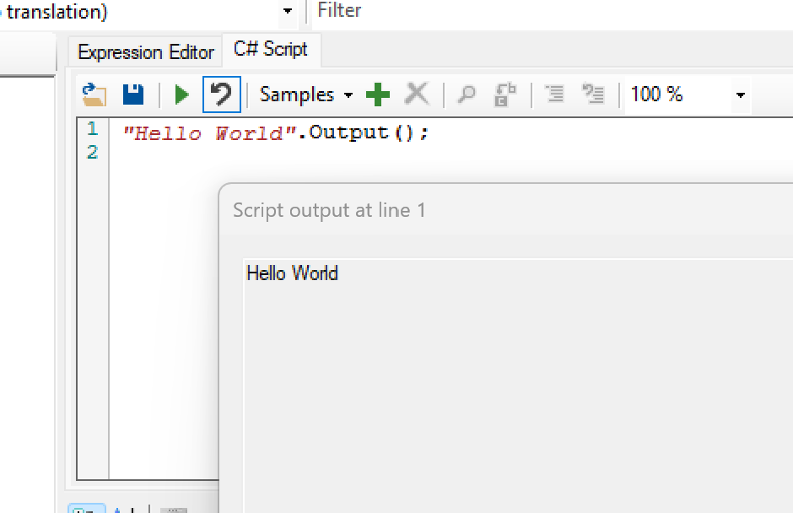
"Hello World".Output();

Slide 21
// This is a comment
/* This is a multi row Comment */

Slide 22
type variableName = value;
var variableName = value;
Int - integers (whole numbers), 123 or -123
double - floating point numbers, 19.99 or -19.99
char - single characters, 'a' or 'B'
string - text, "Hello World"
bool - true or false

Slide 23
List:
var Name = new List<type>();
Dictionary: var Name = new Dictionary<key type, value type>()
{
{key1, value1},
{key2, value2},
{key3, value3} }

Slide 24
“String”.Contains(“Substring”);
“String”.EndsWith (“Substring”);
“String”. Substring(Start, End);
string.Format(“String with placeholder {0}“, Text);

Slide 25
.ToList() or .ToArray();
List.Where(variable => condition);
List<int> numbers = new List<int>() { 1, 2, 4, 8, 16, 32 }; var smallNumbers = numbers.Where(n => n < 10);

Slide 26
foreach (type variableName in arrayName) { // code block to be executed }

Slide 27
for (statement 1; statement 2; statement 3) { // code block to be executed }
Bsp. for (int i = 0; i < 5; i++) { Console.WriteLine(i); }

Slide 28
if (condition1) { // block of code to be executed if condition1 is True }
else if (condition2) { // block of code to be executed if the condition1 is False and condition2 is True }
else { // block of code to be executed if the condition1 is False and condition2 is False }

Slide 29
Objects in Tabular Model

Slide 30
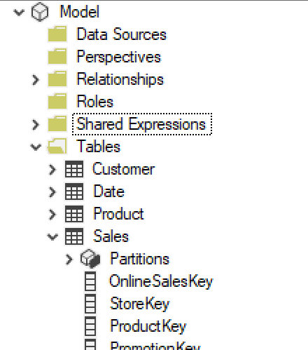
Model
Model.Tables
Model.Tables[“table name”]

Slide 31
Model.Tables[“table name”].Column
Model.Tables[“table name”]
.Column [“column name”]

Slide 32
Model.Tables[“table name”].Measures
Model.Tables[“table name”]
.Measures [“measure name”]

Slide 33
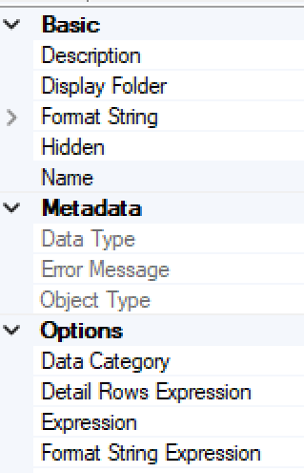
Model.Tables[“table name”]
.Measures [“measure name”]
.Name KPI Quantity
.DaxObjectFullName Sales[KPI Quantity]
.Expression
.DisplayFolder
.FormatString

Slide 34
Model.Tables[“table name”]
.AddMeasure(Name,
Expression,
DisplayFolder)

Slide 35
Generate measures from columns

Slide 36
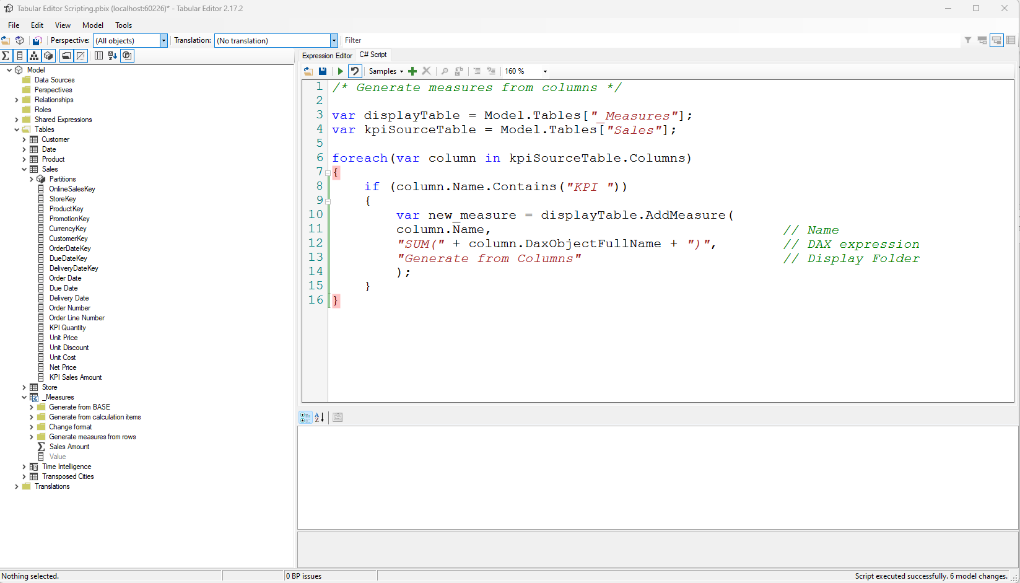

Slide 42
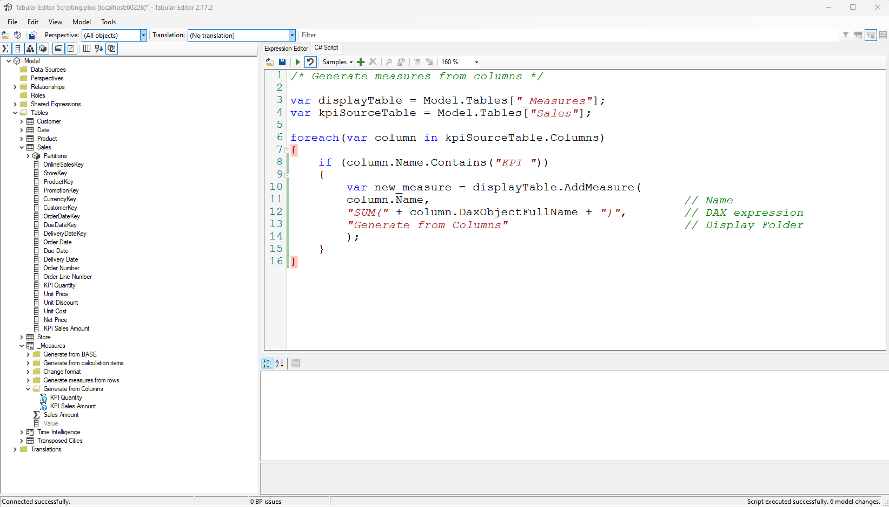

Slide 43
Generate measures from another measures

Slide 44
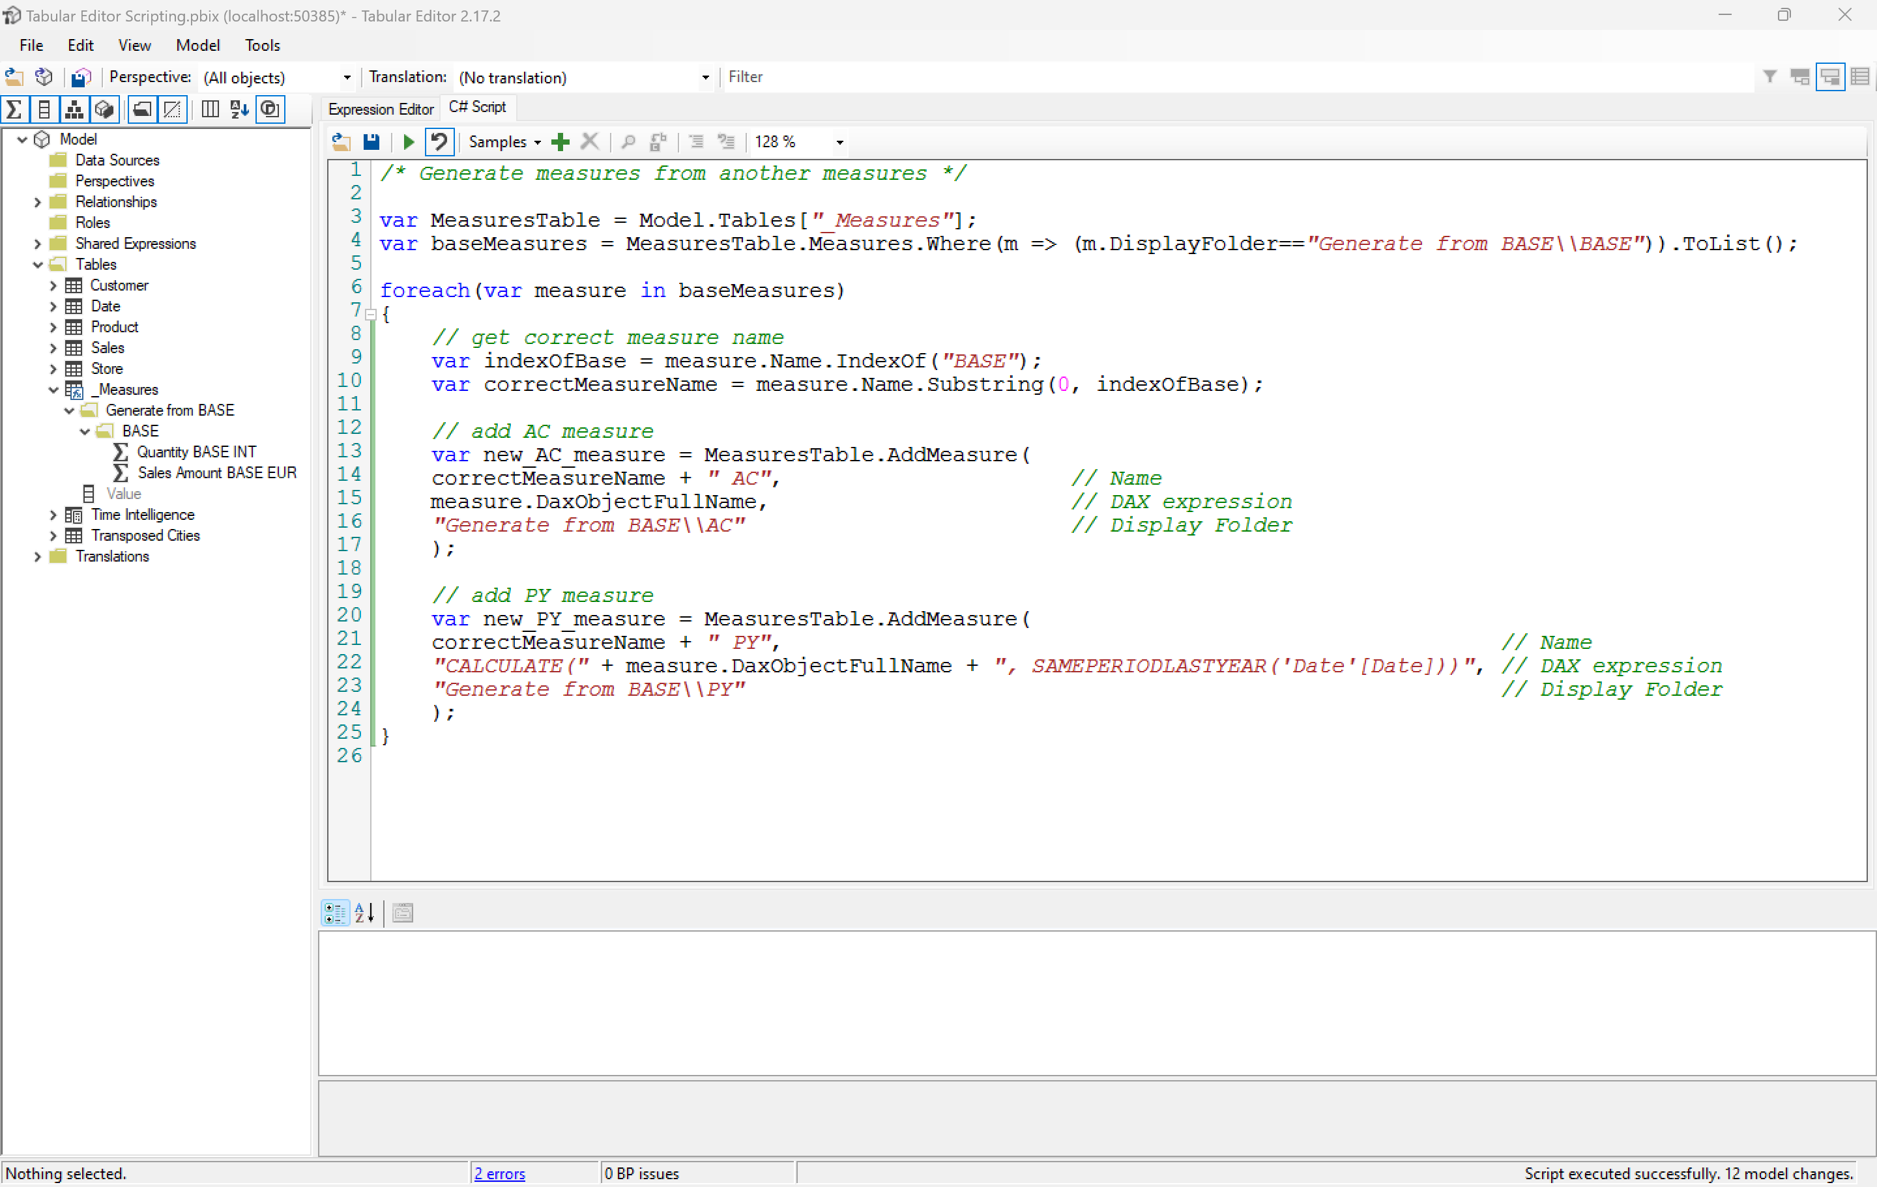

Slide 45
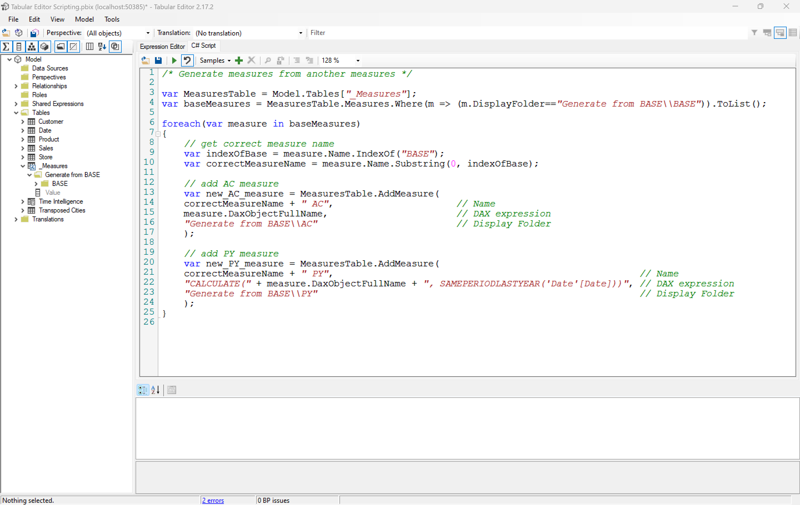

Slide 47
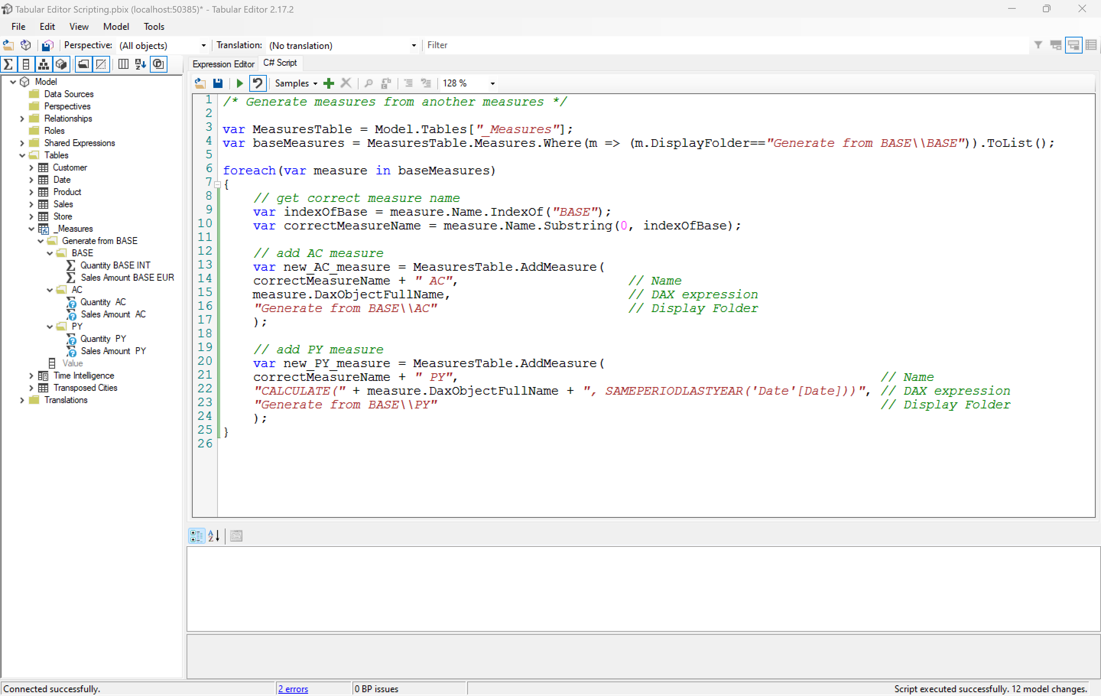

Slide 48
Delete measures

Slide 49
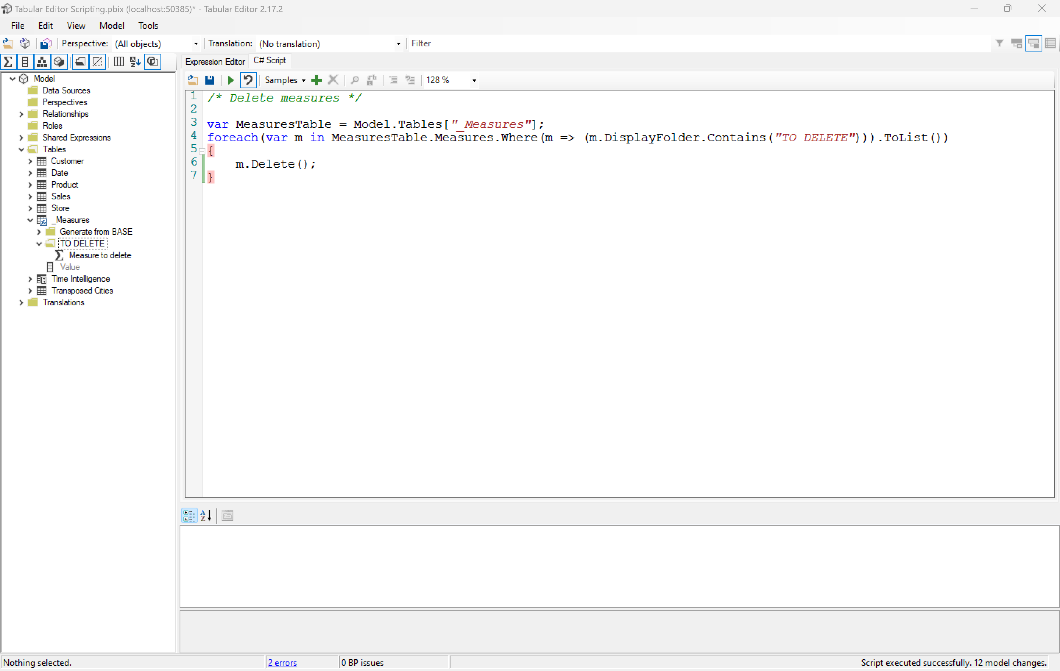

Slide 50

Thank You!

Slide 51

Feedback please!
https://feedback.dsmuc.de/

